Slide 1
Product of the Year
Dashboard

Slide 2
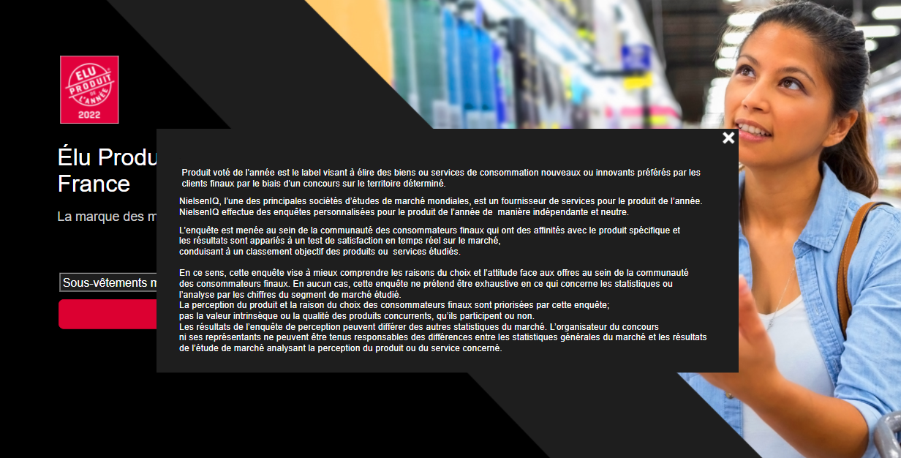
Home
Landing Page
Notes:
slicer
No alt text provided.
actionButton
No alt text provided.
image
No alt text provided.
shape
No alt text provided.
shape
No alt text provided.
shape
No alt text provided.
image
No alt text provided.
image
No alt text provided.
image
No alt text provided.
actionButton
No alt text provided.
actionButton
No alt text provided.
actionButton
No alt text provided.
shape
No alt text provided.
shape
No alt text provided.
actionButton
No alt text provided.
image
No alt text provided.
shape
No alt text provided.
image
No alt text provided.
image
No alt text provided.
shape
No alt text provided.
shape
No alt text provided.

Slide 3
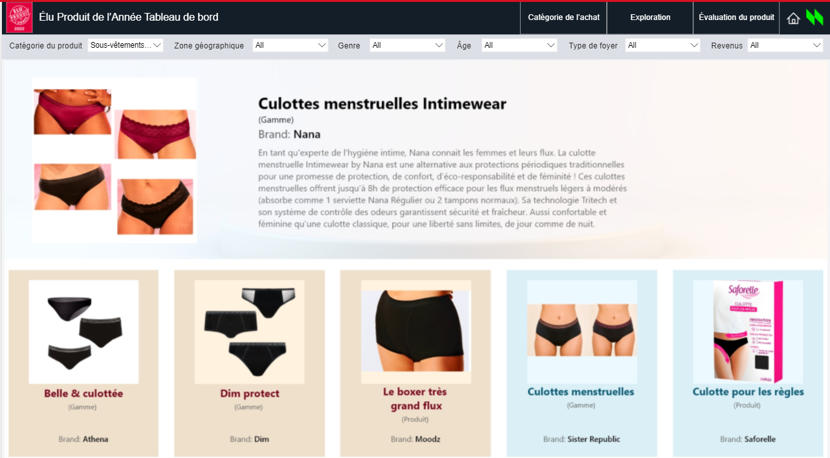
Telephony Functional
Images – Call Outs
Images are being displayed on the product level, Nominated product will be displayed at the top and rest all the competitors will be displayed below
If the nominated product is winner, there will be a logo for “Voted product of the Year”.
Notes:
shape
No alt text provided.
actionButton
No alt text provided.
actionButton
No alt text provided.
actionButton
No alt text provided.
image
No alt text provided.
image
No alt text provided.
image
No alt text provided.
textbox
No alt text provided.
textbox
No alt text provided.
actionButton
No alt text provided.
actionButton
No alt text provided.
shape
No alt text provided.
shape
No alt text provided.
shape
No alt text provided.
shape
No alt text provided.
shape
No alt text provided.
shape
No alt text provided.
shape
No alt text provided.
textbox
No alt text provided.
textbox
No alt text provided.
textbox
No alt text provided.
textbox
No alt text provided.
textbox
No alt text provided.
textbox
No alt text provided.
image
No alt text provided.
actionButton
No alt text provided.
actionButton
No alt text provided.
textbox
No alt text provided.
textbox
No alt text provided.
textbox
No alt text provided.
textbox
No alt text provided.
actionButton
No alt text provided.
actionButton
No alt text provided.
actionButton
No alt text provided.
actionButton
No alt text provided.
actionButton
No alt text provided.
shape
No alt text provided.
shape
No alt text provided.
textbox
No alt text provided.
textbox
No alt text provided.
textbox
No alt text provided.
textbox
No alt text provided.
textbox
No alt text provided.
textbox
No alt text provided.
textbox
No alt text provided.
textbox
No alt text provided.
slicer
No alt text provided.
slicer
No alt text provided.
slicer
No alt text provided.
slicer
No alt text provided.
slicer
No alt text provided.
slicer
No alt text provided.
barChart
No alt text provided.
barChart
No alt text provided.
barChart
No alt text provided.
barChart
No alt text provided.
barChart
No alt text provided.
card
No alt text provided.
card
No alt text provided.
card
No alt text provided.
tableEx
No alt text provided.
card
No alt text provided.
card
No alt text provided.
card
No alt text provided.
tableEx
No alt text provided.
card
No alt text provided.
tableEx
No alt text provided.
tableEx
No alt text provided.
tableEx
No alt text provided.
barChart
No alt text provided.
card
No alt text provided.
card
No alt text provided.
card
No alt text provided.
card
No alt text provided.
card
No alt text provided.
card
No alt text provided.
card
No alt text provided.
card
No alt text provided.
card
No alt text provided.
card
No alt text provided.
barChart
No alt text provided.
barChart
No alt text provided.
barChart
No alt text provided.
barChart
No alt text provided.
barChart
No alt text provided.
barChart
No alt text provided.
barChart
No alt text provided.
barChart
No alt text provided.
barChart
No alt text provided.
barChart
No alt text provided.
card
No alt text provided.
card
No alt text provided.
card
No alt text provided.
card
No alt text provided.
card
No alt text provided.
card
No alt text provided.
card
No alt text provided.
card
No alt text provided.
card
No alt text provided.
card
No alt text provided.
card
No alt text provided.
card
No alt text provided.
card
No alt text provided.
card
No alt text provided.
card
No alt text provided.
card
No alt text provided.
card
No alt text provided.
card
No alt text provided.
card
No alt text provided.
card
No alt text provided.
card
No alt text provided.
card
No alt text provided.
card
No alt text provided.
card
No alt text provided.
card
No alt text provided.
card
No alt text provided.
card
No alt text provided.
card
No alt text provided.
card
No alt text provided.
card
No alt text provided.
card
No alt text provided.
card
No alt text provided.
card
No alt text provided.
card
No alt text provided.
textbox
No alt text provided.
textbox
No alt text provided.
textbox
No alt text provided.
textbox
No alt text provided.
textbox
No alt text provided.
textbox
No alt text provided.

Slide 4
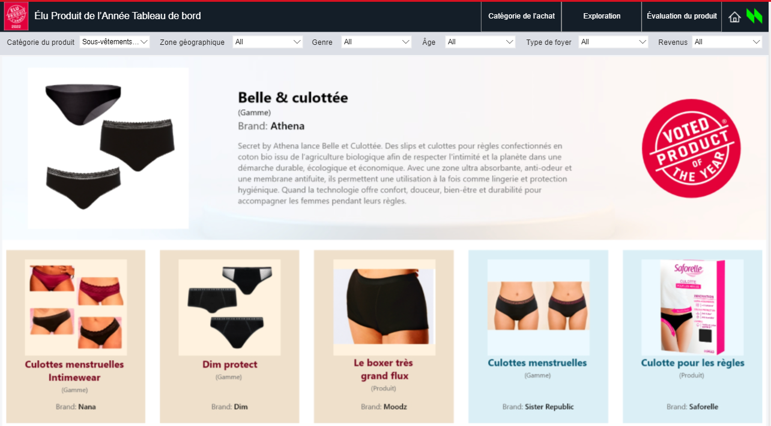
Telephony Functional
Images – Call Outs
Notes:
shape
No alt text provided.
actionButton
No alt text provided.
actionButton
No alt text provided.
actionButton
No alt text provided.
image
No alt text provided.
image
No alt text provided.
image
No alt text provided.
textbox
No alt text provided.
textbox
No alt text provided.
actionButton
No alt text provided.
actionButton
No alt text provided.
shape
No alt text provided.
shape
No alt text provided.
shape
No alt text provided.
shape
No alt text provided.
shape
No alt text provided.
shape
No alt text provided.
shape
No alt text provided.
textbox
No alt text provided.
textbox
No alt text provided.
textbox
No alt text provided.
textbox
No alt text provided.
textbox
No alt text provided.
textbox
No alt text provided.
image
No alt text provided.
actionButton
No alt text provided.
actionButton
No alt text provided.
textbox
No alt text provided.
textbox
No alt text provided.
textbox
No alt text provided.
textbox
No alt text provided.
actionButton
No alt text provided.
actionButton
No alt text provided.
actionButton
No alt text provided.
actionButton
No alt text provided.
actionButton
No alt text provided.
shape
No alt text provided.
shape
No alt text provided.
textbox
No alt text provided.
textbox
No alt text provided.
textbox
No alt text provided.
textbox
No alt text provided.
textbox
No alt text provided.
textbox
No alt text provided.
textbox
No alt text provided.
textbox
No alt text provided.
slicer
No alt text provided.
slicer
No alt text provided.
slicer
No alt text provided.
slicer
No alt text provided.
slicer
No alt text provided.
slicer
No alt text provided.
barChart
No alt text provided.
barChart
No alt text provided.
barChart
No alt text provided.
barChart
No alt text provided.
barChart
No alt text provided.
card
No alt text provided.
card
No alt text provided.
card
No alt text provided.
tableEx
No alt text provided.
card
No alt text provided.
card
No alt text provided.
card
No alt text provided.
tableEx
No alt text provided.
card
No alt text provided.
tableEx
No alt text provided.
tableEx
No alt text provided.
tableEx
No alt text provided.
barChart
No alt text provided.
card
No alt text provided.
card
No alt text provided.
card
No alt text provided.
card
No alt text provided.
card
No alt text provided.
card
No alt text provided.
card
No alt text provided.
card
No alt text provided.
card
No alt text provided.
card
No alt text provided.
barChart
No alt text provided.
barChart
No alt text provided.
barChart
No alt text provided.
barChart
No alt text provided.
barChart
No alt text provided.
barChart
No alt text provided.
barChart
No alt text provided.
barChart
No alt text provided.
barChart
No alt text provided.
barChart
No alt text provided.
card
No alt text provided.
card
No alt text provided.
card
No alt text provided.
card
No alt text provided.
card
No alt text provided.
card
No alt text provided.
card
No alt text provided.
card
No alt text provided.
card
No alt text provided.
card
No alt text provided.
card
No alt text provided.
card
No alt text provided.
card
No alt text provided.
card
No alt text provided.
card
No alt text provided.
card
No alt text provided.
card
No alt text provided.
card
No alt text provided.
card
No alt text provided.
card
No alt text provided.
card
No alt text provided.
card
No alt text provided.
card
No alt text provided.
card
No alt text provided.
card
No alt text provided.
card
No alt text provided.
card
No alt text provided.
card
No alt text provided.
card
No alt text provided.
card
No alt text provided.
card
No alt text provided.
card
No alt text provided.
card
No alt text provided.
card
No alt text provided.
textbox
No alt text provided.
textbox
No alt text provided.
textbox
No alt text provided.
textbox
No alt text provided.
textbox
No alt text provided.
textbox
No alt text provided.

Slide 5
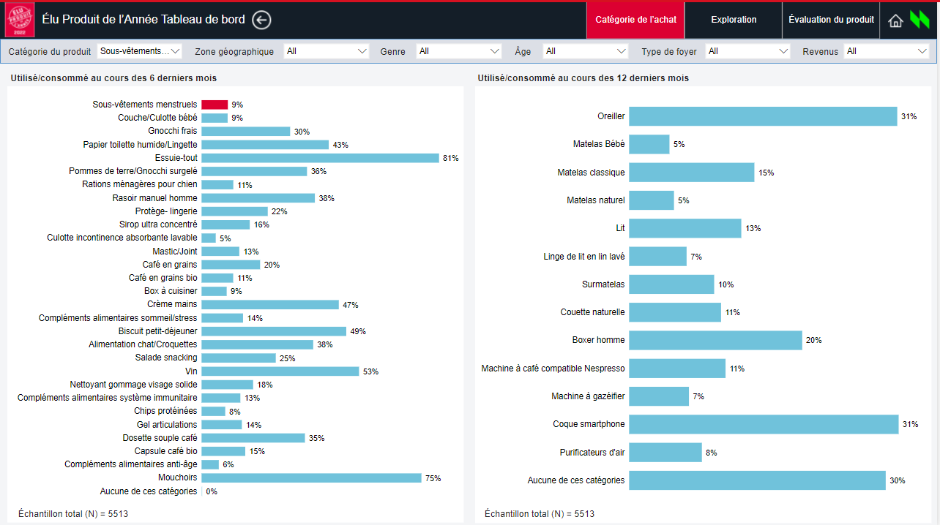
Telephony Functional
Category Purchased – Call Outs
This screen shows all the values on the Category level.
The selected category will be displayed in red color.
Notes:
shape
No alt text provided.
actionButton
No alt text provided.
actionButton
No alt text provided.
actionButton
No alt text provided.
image
No alt text provided.
image
No alt text provided.
image
No alt text provided.
textbox
No alt text provided.
textbox
No alt text provided.
actionButton
No alt text provided.
actionButton
No alt text provided.
shape
No alt text provided.
shape
No alt text provided.
shape
No alt text provided.
shape
No alt text provided.
shape
No alt text provided.
shape
No alt text provided.
shape
No alt text provided.
textbox
No alt text provided.
textbox
No alt text provided.
textbox
No alt text provided.
textbox
No alt text provided.
textbox
No alt text provided.
textbox
No alt text provided.
image
No alt text provided.
actionButton
No alt text provided.
actionButton
No alt text provided.
textbox
No alt text provided.
textbox
No alt text provided.
textbox
No alt text provided.
textbox
No alt text provided.
actionButton
No alt text provided.
actionButton
No alt text provided.
actionButton
No alt text provided.
actionButton
No alt text provided.
actionButton
No alt text provided.
shape
No alt text provided.
shape
No alt text provided.
textbox
No alt text provided.
textbox
No alt text provided.
textbox
No alt text provided.
textbox
No alt text provided.
textbox
No alt text provided.
textbox
No alt text provided.
textbox
No alt text provided.
textbox
No alt text provided.
slicer
No alt text provided.
slicer
No alt text provided.
slicer
No alt text provided.
slicer
No alt text provided.
slicer
No alt text provided.
slicer
No alt text provided.
barChart
No alt text provided.
barChart
No alt text provided.
barChart
No alt text provided.
barChart
No alt text provided.
barChart
No alt text provided.
card
No alt text provided.
card
No alt text provided.
card
No alt text provided.
tableEx
No alt text provided.
card
No alt text provided.
card
No alt text provided.
card
No alt text provided.
tableEx
No alt text provided.
card
No alt text provided.
tableEx
No alt text provided.
tableEx
No alt text provided.
tableEx
No alt text provided.
barChart
No alt text provided.
card
No alt text provided.
card
No alt text provided.
card
No alt text provided.
card
No alt text provided.
card
No alt text provided.
card
No alt text provided.
card
No alt text provided.
card
No alt text provided.
card
No alt text provided.
card
No alt text provided.
barChart
No alt text provided.
barChart
No alt text provided.
barChart
No alt text provided.
barChart
No alt text provided.
barChart
No alt text provided.
barChart
No alt text provided.
barChart
No alt text provided.
barChart
No alt text provided.
barChart
No alt text provided.
barChart
No alt text provided.
card
No alt text provided.
card
No alt text provided.
card
No alt text provided.
card
No alt text provided.
card
No alt text provided.
card
No alt text provided.
card
No alt text provided.
card
No alt text provided.
card
No alt text provided.
card
No alt text provided.
card
No alt text provided.
card
No alt text provided.
card
No alt text provided.
card
No alt text provided.
card
No alt text provided.
card
No alt text provided.
card
No alt text provided.
card
No alt text provided.
card
No alt text provided.
card
No alt text provided.
card
No alt text provided.
card
No alt text provided.
card
No alt text provided.
card
No alt text provided.
card
No alt text provided.
card
No alt text provided.
card
No alt text provided.
card
No alt text provided.
card
No alt text provided.
card
No alt text provided.
card
No alt text provided.
card
No alt text provided.
card
No alt text provided.
card
No alt text provided.
textbox
No alt text provided.
textbox
No alt text provided.
textbox
No alt text provided.
textbox
No alt text provided.
textbox
No alt text provided.
textbox
No alt text provided.

Slide 6
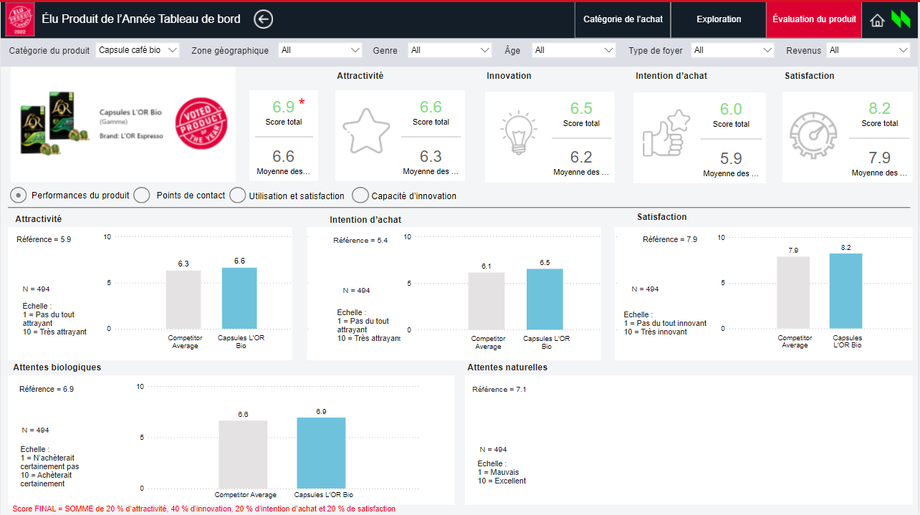
Telephony Functional
Product Performance – Call Outs
1. Natural biological visual has been newly added on this screen.
2. Products like Compléments alimentaires système immunitaire, Chips protéinées, Boxer homme and Gel articulations will show different competitor value because certain product categories no longer exist.
Notes:
shape
No alt text provided.
actionButton
No alt text provided.
actionButton
No alt text provided.
actionButton
No alt text provided.
image
No alt text provided.
image
No alt text provided.
image
No alt text provided.
textbox
No alt text provided.
textbox
No alt text provided.
actionButton
No alt text provided.
actionButton
No alt text provided.
shape
No alt text provided.
shape
No alt text provided.
shape
No alt text provided.
shape
No alt text provided.
shape
No alt text provided.
shape
No alt text provided.
shape
No alt text provided.
textbox
No alt text provided.
textbox
No alt text provided.
textbox
No alt text provided.
textbox
No alt text provided.
textbox
No alt text provided.
textbox
No alt text provided.
image
No alt text provided.
actionButton
No alt text provided.
actionButton
No alt text provided.
textbox
No alt text provided.
textbox
No alt text provided.
textbox
No alt text provided.
textbox
No alt text provided.
actionButton
No alt text provided.
actionButton
No alt text provided.
actionButton
No alt text provided.
actionButton
No alt text provided.
actionButton
No alt text provided.
shape
No alt text provided.
shape
No alt text provided.
textbox
No alt text provided.
textbox
No alt text provided.
textbox
No alt text provided.
textbox
No alt text provided.
textbox
No alt text provided.
textbox
No alt text provided.
textbox
No alt text provided.
textbox
No alt text provided.
slicer
No alt text provided.
slicer
No alt text provided.
slicer
No alt text provided.
slicer
No alt text provided.
slicer
No alt text provided.
slicer
No alt text provided.
barChart
No alt text provided.
barChart
No alt text provided.
barChart
No alt text provided.
barChart
No alt text provided.
barChart
No alt text provided.
card
No alt text provided.
card
No alt text provided.
card
No alt text provided.
tableEx
No alt text provided.
card
No alt text provided.
card
No alt text provided.
card
No alt text provided.
tableEx
No alt text provided.
card
No alt text provided.
tableEx
No alt text provided.
tableEx
No alt text provided.
tableEx
No alt text provided.
barChart
No alt text provided.
card
No alt text provided.
card
No alt text provided.
card
No alt text provided.
card
No alt text provided.
card
No alt text provided.
card
No alt text provided.
card
No alt text provided.
card
No alt text provided.
card
No alt text provided.
card
No alt text provided.
barChart
No alt text provided.
barChart
No alt text provided.
barChart
No alt text provided.
barChart
No alt text provided.
barChart
No alt text provided.
barChart
No alt text provided.
barChart
No alt text provided.
barChart
No alt text provided.
barChart
No alt text provided.
barChart
No alt text provided.
card
No alt text provided.
card
No alt text provided.
card
No alt text provided.
card
No alt text provided.
card
No alt text provided.
card
No alt text provided.
card
No alt text provided.
card
No alt text provided.
card
No alt text provided.
card
No alt text provided.
card
No alt text provided.
card
No alt text provided.
card
No alt text provided.
card
No alt text provided.
card
No alt text provided.
card
No alt text provided.
card
No alt text provided.
card
No alt text provided.
card
No alt text provided.
card
No alt text provided.
card
No alt text provided.
card
No alt text provided.
card
No alt text provided.
card
No alt text provided.
card
No alt text provided.
card
No alt text provided.
card
No alt text provided.
card
No alt text provided.
card
No alt text provided.
card
No alt text provided.
card
No alt text provided.
card
No alt text provided.
card
No alt text provided.
card
No alt text provided.
textbox
No alt text provided.
textbox
No alt text provided.
textbox
No alt text provided.
textbox
No alt text provided.
textbox
No alt text provided.
textbox
No alt text provided.

Slide 7
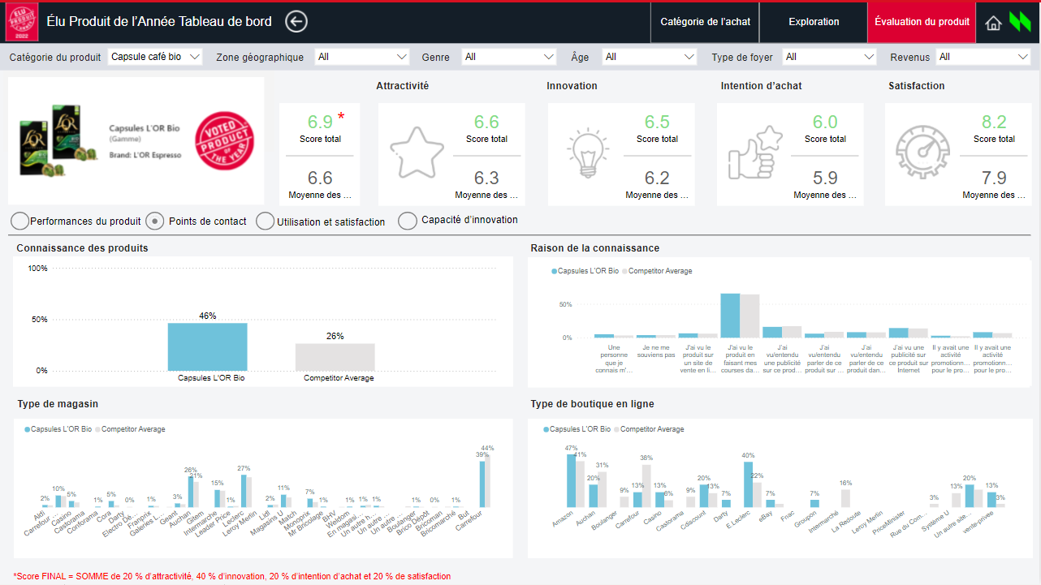
Telephony Functional
Touchpoints – Call Outs
1. Two new visuals on this screen has been added to this screen : Type of Online store and Type of store,
Notes:
shape
No alt text provided.
actionButton
No alt text provided.
actionButton
No alt text provided.
actionButton
No alt text provided.
image
No alt text provided.
image
No alt text provided.
image
No alt text provided.
textbox
No alt text provided.
textbox
No alt text provided.
actionButton
No alt text provided.
actionButton
No alt text provided.
shape
No alt text provided.
shape
No alt text provided.
shape
No alt text provided.
shape
No alt text provided.
shape
No alt text provided.
shape
No alt text provided.
shape
No alt text provided.
textbox
No alt text provided.
textbox
No alt text provided.
textbox
No alt text provided.
textbox
No alt text provided.
textbox
No alt text provided.
textbox
No alt text provided.
image
No alt text provided.
actionButton
No alt text provided.
actionButton
No alt text provided.
textbox
No alt text provided.
textbox
No alt text provided.
textbox
No alt text provided.
textbox
No alt text provided.
actionButton
No alt text provided.
actionButton
No alt text provided.
actionButton
No alt text provided.
actionButton
No alt text provided.
actionButton
No alt text provided.
shape
No alt text provided.
shape
No alt text provided.
textbox
No alt text provided.
textbox
No alt text provided.
textbox
No alt text provided.
textbox
No alt text provided.
textbox
No alt text provided.
textbox
No alt text provided.
textbox
No alt text provided.
textbox
No alt text provided.
slicer
No alt text provided.
slicer
No alt text provided.
slicer
No alt text provided.
slicer
No alt text provided.
slicer
No alt text provided.
slicer
No alt text provided.
barChart
No alt text provided.
barChart
No alt text provided.
barChart
No alt text provided.
barChart
No alt text provided.
barChart
No alt text provided.
card
No alt text provided.
card
No alt text provided.
card
No alt text provided.
tableEx
No alt text provided.
card
No alt text provided.
card
No alt text provided.
card
No alt text provided.
tableEx
No alt text provided.
card
No alt text provided.
tableEx
No alt text provided.
tableEx
No alt text provided.
tableEx
No alt text provided.
barChart
No alt text provided.
card
No alt text provided.
card
No alt text provided.
card
No alt text provided.
card
No alt text provided.
card
No alt text provided.
card
No alt text provided.
card
No alt text provided.
card
No alt text provided.
card
No alt text provided.
card
No alt text provided.
barChart
No alt text provided.
barChart
No alt text provided.
barChart
No alt text provided.
barChart
No alt text provided.
barChart
No alt text provided.
barChart
No alt text provided.
barChart
No alt text provided.
barChart
No alt text provided.
barChart
No alt text provided.
barChart
No alt text provided.
card
No alt text provided.
card
No alt text provided.
card
No alt text provided.
card
No alt text provided.
card
No alt text provided.
card
No alt text provided.
card
No alt text provided.
card
No alt text provided.
card
No alt text provided.
card
No alt text provided.
card
No alt text provided.
card
No alt text provided.
card
No alt text provided.
card
No alt text provided.
card
No alt text provided.
card
No alt text provided.
card
No alt text provided.
card
No alt text provided.
card
No alt text provided.
card
No alt text provided.
card
No alt text provided.
card
No alt text provided.
card
No alt text provided.
card
No alt text provided.
card
No alt text provided.
card
No alt text provided.
card
No alt text provided.
card
No alt text provided.
card
No alt text provided.
card
No alt text provided.
card
No alt text provided.
card
No alt text provided.
card
No alt text provided.
card
No alt text provided.
textbox
No alt text provided.
textbox
No alt text provided.
textbox
No alt text provided.
textbox
No alt text provided.
textbox
No alt text provided.
textbox
No alt text provided.

Slide 8
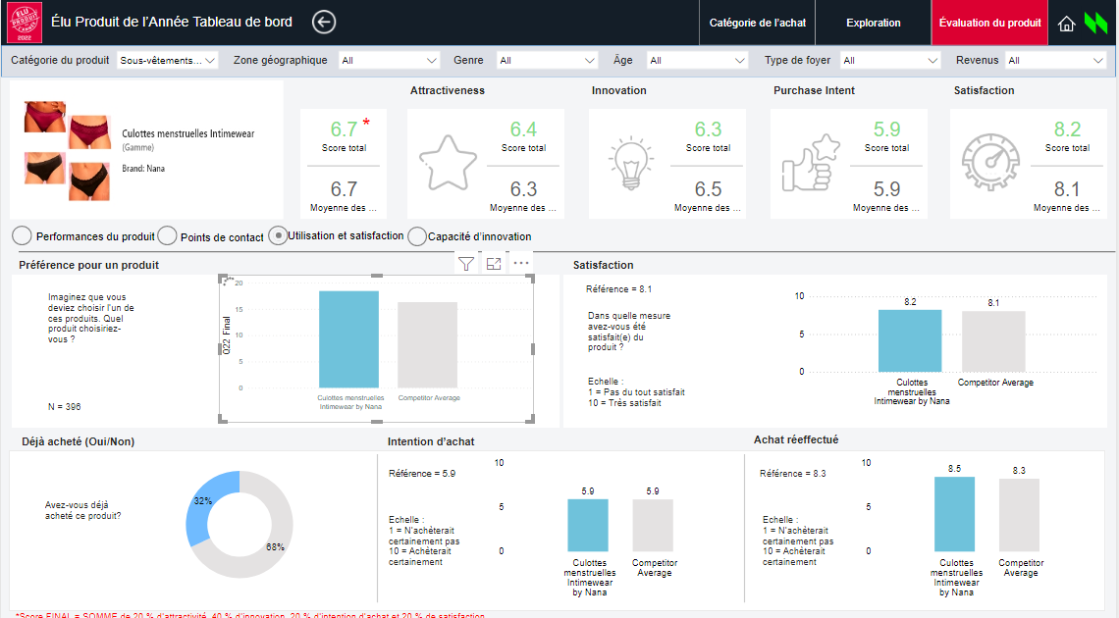
Telephony Functional
Usage & Satisfaction – Call Outs
Three new visuals on this screen has been added to the dashboard
Product preference visual has been used on a bar chart. As, competitor and nominated product values under donut chart were getting divided by 100% because of donut charts functionality.
Notes:
shape
No alt text provided.
actionButton
No alt text provided.
actionButton
No alt text provided.
actionButton
No alt text provided.
image
No alt text provided.
image
No alt text provided.
image
No alt text provided.
textbox
No alt text provided.
textbox
No alt text provided.
actionButton
No alt text provided.
actionButton
No alt text provided.
shape
No alt text provided.
shape
No alt text provided.
shape
No alt text provided.
shape
No alt text provided.
shape
No alt text provided.
shape
No alt text provided.
shape
No alt text provided.
textbox
No alt text provided.
textbox
No alt text provided.
textbox
No alt text provided.
textbox
No alt text provided.
textbox
No alt text provided.
textbox
No alt text provided.
image
No alt text provided.
actionButton
No alt text provided.
actionButton
No alt text provided.
textbox
No alt text provided.
textbox
No alt text provided.
textbox
No alt text provided.
textbox
No alt text provided.
actionButton
No alt text provided.
actionButton
No alt text provided.
actionButton
No alt text provided.
actionButton
No alt text provided.
actionButton
No alt text provided.
shape
No alt text provided.
shape
No alt text provided.
textbox
No alt text provided.
textbox
No alt text provided.
textbox
No alt text provided.
textbox
No alt text provided.
textbox
No alt text provided.
textbox
No alt text provided.
textbox
No alt text provided.
textbox
No alt text provided.
slicer
No alt text provided.
slicer
No alt text provided.
slicer
No alt text provided.
slicer
No alt text provided.
slicer
No alt text provided.
slicer
No alt text provided.
barChart
No alt text provided.
barChart
No alt text provided.
barChart
No alt text provided.
barChart
No alt text provided.
barChart
No alt text provided.
card
No alt text provided.
card
No alt text provided.
card
No alt text provided.
tableEx
No alt text provided.
card
No alt text provided.
card
No alt text provided.
card
No alt text provided.
tableEx
No alt text provided.
card
No alt text provided.
tableEx
No alt text provided.
tableEx
No alt text provided.
tableEx
No alt text provided.
barChart
No alt text provided.
card
No alt text provided.
card
No alt text provided.
card
No alt text provided.
card
No alt text provided.
card
No alt text provided.
card
No alt text provided.
card
No alt text provided.
card
No alt text provided.
card
No alt text provided.
card
No alt text provided.
barChart
No alt text provided.
barChart
No alt text provided.
barChart
No alt text provided.
barChart
No alt text provided.
barChart
No alt text provided.
barChart
No alt text provided.
barChart
No alt text provided.
barChart
No alt text provided.
barChart
No alt text provided.
barChart
No alt text provided.
card
No alt text provided.
card
No alt text provided.
card
No alt text provided.
card
No alt text provided.
card
No alt text provided.
card
No alt text provided.
card
No alt text provided.
card
No alt text provided.
card
No alt text provided.
card
No alt text provided.
card
No alt text provided.
card
No alt text provided.
card
No alt text provided.
card
No alt text provided.
card
No alt text provided.
card
No alt text provided.
card
No alt text provided.
card
No alt text provided.
card
No alt text provided.
card
No alt text provided.
card
No alt text provided.
card
No alt text provided.
card
No alt text provided.
card
No alt text provided.
card
No alt text provided.
card
No alt text provided.
card
No alt text provided.
card
No alt text provided.
card
No alt text provided.
card
No alt text provided.
card
No alt text provided.
card
No alt text provided.
card
No alt text provided.
card
No alt text provided.
textbox
No alt text provided.
textbox
No alt text provided.
textbox
No alt text provided.
textbox
No alt text provided.
textbox
No alt text provided.
textbox
No alt text provided.

Slide 9
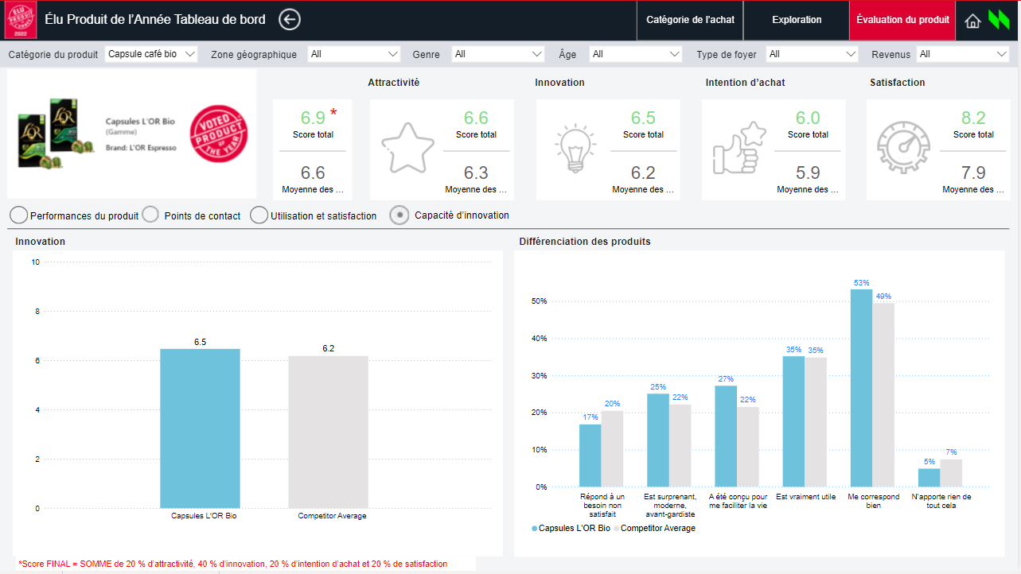
Telephony Functional
Innovativeness – Call Outs
As per requirement, Innovativeness screen has been newly created.
Notes:
shape
No alt text provided.
actionButton
No alt text provided.
actionButton
No alt text provided.
actionButton
No alt text provided.
image
No alt text provided.
image
No alt text provided.
image
No alt text provided.
textbox
No alt text provided.
textbox
No alt text provided.
actionButton
No alt text provided.
actionButton
No alt text provided.
shape
No alt text provided.
shape
No alt text provided.
shape
No alt text provided.
shape
No alt text provided.
shape
No alt text provided.
shape
No alt text provided.
shape
No alt text provided.
textbox
No alt text provided.
textbox
No alt text provided.
textbox
No alt text provided.
textbox
No alt text provided.
textbox
No alt text provided.
textbox
No alt text provided.
image
No alt text provided.
actionButton
No alt text provided.
actionButton
No alt text provided.
textbox
No alt text provided.
textbox
No alt text provided.
textbox
No alt text provided.
textbox
No alt text provided.
actionButton
No alt text provided.
actionButton
No alt text provided.
actionButton
No alt text provided.
actionButton
No alt text provided.
actionButton
No alt text provided.
shape
No alt text provided.
shape
No alt text provided.
textbox
No alt text provided.
textbox
No alt text provided.
textbox
No alt text provided.
textbox
No alt text provided.
textbox
No alt text provided.
textbox
No alt text provided.
textbox
No alt text provided.
textbox
No alt text provided.
slicer
No alt text provided.
slicer
No alt text provided.
slicer
No alt text provided.
slicer
No alt text provided.
slicer
No alt text provided.
slicer
No alt text provided.
barChart
No alt text provided.
barChart
No alt text provided.
barChart
No alt text provided.
barChart
No alt text provided.
barChart
No alt text provided.
card
No alt text provided.
card
No alt text provided.
card
No alt text provided.
tableEx
No alt text provided.
card
No alt text provided.
card
No alt text provided.
card
No alt text provided.
tableEx
No alt text provided.
card
No alt text provided.
tableEx
No alt text provided.
tableEx
No alt text provided.
tableEx
No alt text provided.
barChart
No alt text provided.
card
No alt text provided.
card
No alt text provided.
card
No alt text provided.
card
No alt text provided.
card
No alt text provided.
card
No alt text provided.
card
No alt text provided.
card
No alt text provided.
card
No alt text provided.
card
No alt text provided.
barChart
No alt text provided.
barChart
No alt text provided.
barChart
No alt text provided.
barChart
No alt text provided.
barChart
No alt text provided.
barChart
No alt text provided.
barChart
No alt text provided.
barChart
No alt text provided.
barChart
No alt text provided.
barChart
No alt text provided.
card
No alt text provided.
card
No alt text provided.
card
No alt text provided.
card
No alt text provided.
card
No alt text provided.
card
No alt text provided.
card
No alt text provided.
card
No alt text provided.
card
No alt text provided.
card
No alt text provided.
card
No alt text provided.
card
No alt text provided.
card
No alt text provided.
card
No alt text provided.
card
No alt text provided.
card
No alt text provided.
card
No alt text provided.
card
No alt text provided.
card
No alt text provided.
card
No alt text provided.
card
No alt text provided.
card
No alt text provided.
card
No alt text provided.
card
No alt text provided.
card
No alt text provided.
card
No alt text provided.
card
No alt text provided.
card
No alt text provided.
card
No alt text provided.
card
No alt text provided.
card
No alt text provided.
card
No alt text provided.
card
No alt text provided.
card
No alt text provided.
textbox
No alt text provided.
textbox
No alt text provided.
textbox
No alt text provided.
textbox
No alt text provided.
textbox
No alt text provided.
textbox
No alt text provided.

